Slide 1

Operating Systems Design​ Session 22: Page Table and Paging
19CS2106R​
© 2020 KL University

Slide 2
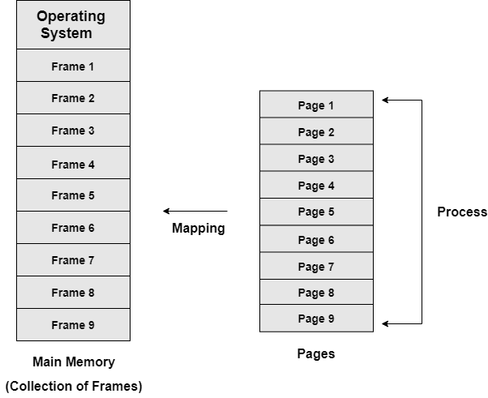
Paging
The Idea behind paging is to divide the process in pages so that, we can store them in the memory at different non contiguous location.
Frames:
Divide physical memory into fixed-sized blocks called frames. Size is power of 2, between 512 bytes and 16 Mbytes
Pages
Divide Process logical memory into blocks of same size called pages
Pages of the process are brought into the main memory only when they are required otherwise they reside in the secondary storage.

Slide 3
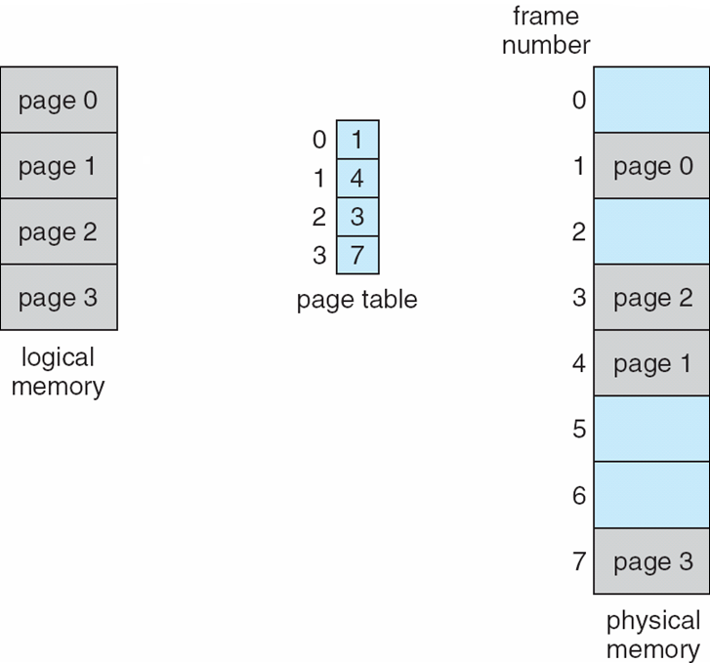
Page Table
Page tables are the mechanism through which the operating system controls what memory addresses mean
Process
Page Table:
Set up a page table to translate logical to physical addresses
Address generated by CPU is divided into:
Page number (p) – used as an index into a page table which contains base address of each page in physical memory
Page offset (d) – combined with base address to define the physical memory address that is sent to the memory unit

Slide 4
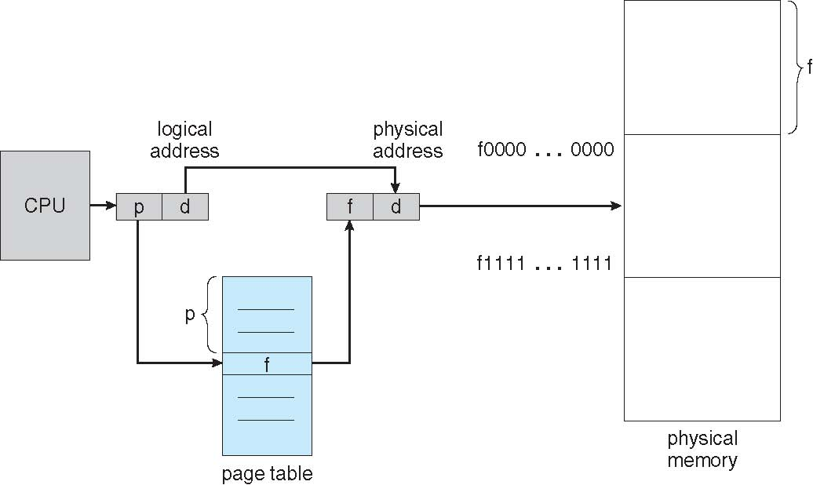
Page Size and Page Table Size (32 Bit Architecture)
If Page size is 4 KB then 20 Bits are used for Page Number resulting in 4 MB size Page Table. – Per Process
2 Power (20) x 32 Bits (4 Bytes) = 4 MB
Larger Page size will reduce Page table size but waster memory.
Smaller page size will increase page table size.
4KB is standard size for many processor architectures.
4 MB continuous space in memory is needed for each Page Table.

Slide 5
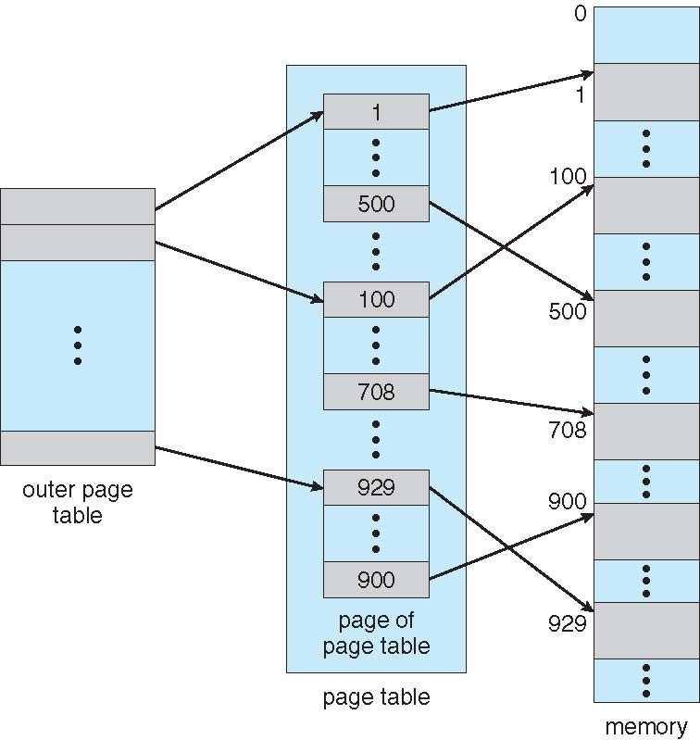
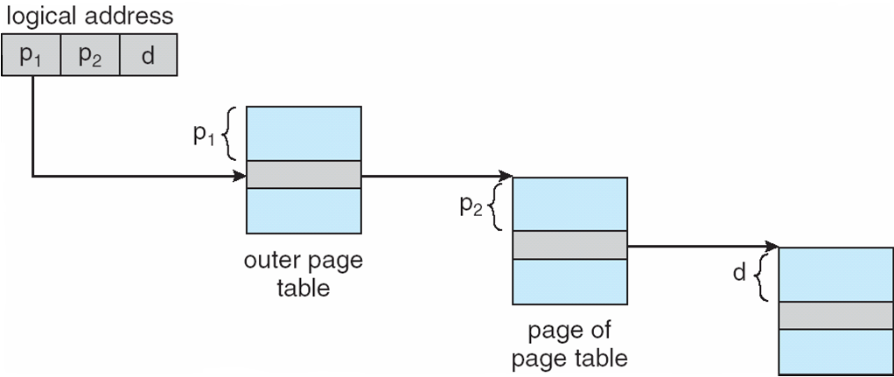
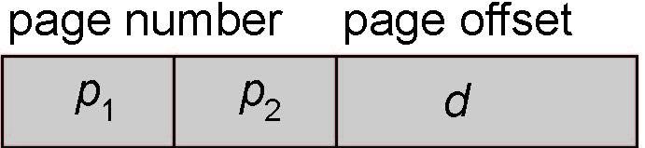
Hierarchical Page Tables
Break up the logical address space into multiple page tables
A simple technique is a two-level page table
Outer Page Table 4 KB
Inner Page table 4 KB each
2 power (10) x 32 bits (4 Bytes)
10 10 12

Slide 6
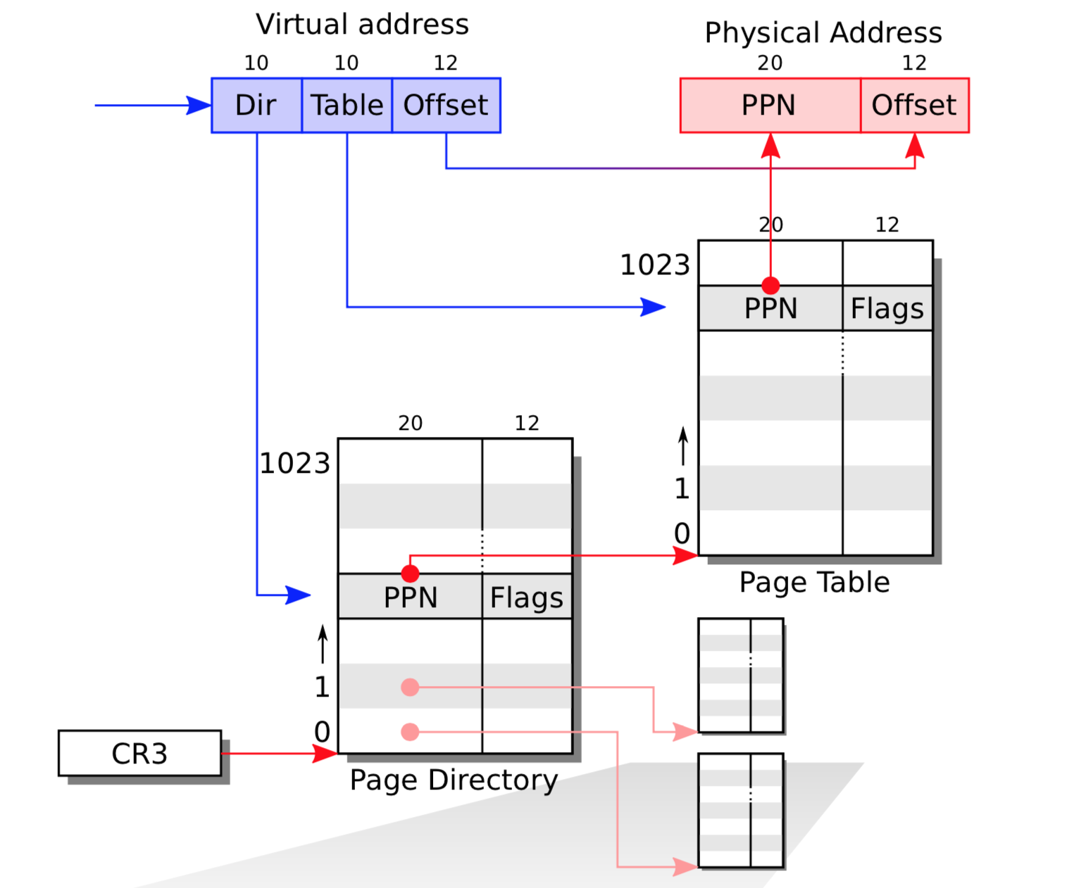
Page Table in x86
page table is stored in physical memory as a two-level tree.
root of the tree is a 4096-byte page directory
contains 1024 PTE-like references to page table pages.
Each page table page is an array of 1024 32-bit PTEs
uses the top 10 bits of a virtual address to select a page directory entry.
If the page directory entry is present, the paging hardware uses the next 10 bits of the virtual address to select a PTE from the page table page that the page directory entry refers to.

Slide 7
Page Table in x86
An x86 page table is logically an array of 2^20 (1,048,576) page table entries (PTEs).
Each PTE contains a 20-bit physical page number (PPN) and some flags.
using its top 20 bits to index into the page table to find a PTE
replacing the address’s top 20 bits with the PPN in the PTE.
The paging hardware copies the low 12 bits unchanged from the virtual to the vtranslated physical address.
Thus a page table gives the operating system control over virtual-to-physical address translations at the granularity of aligned chunks of 4096 (2^12) bytes.
Such a chunk is called a page.

Slide 8
Poll
How many Bits are used for selecting PTE of Page Table that is referred by Page Directory
12
10
15
20

Slide 9
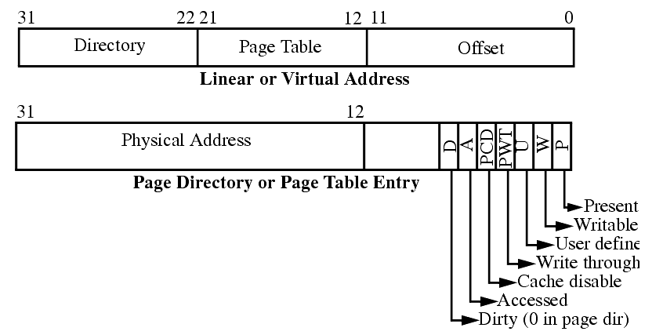
Page Table
Format
Each PTE contains flag bits that tell the paging hardware how the associated virtual address is allowed to be used.
PTE_P indicates whether the PTE is present:
if it is not set, a reference to the page causes a fault (i.e. is not allowed).
PTE_W controls whether instructions are allowed to issue writes to the page;
if not set, only reads and instruction fetches are allowed.
PTE_U controls whether user programs are allowed to use the page;
if clear, only the kernel is allowed to use the page.
Physical memory refers to storage cells in DRAM.
A byte of physical memory has an address, called a physical address.

Slide 10
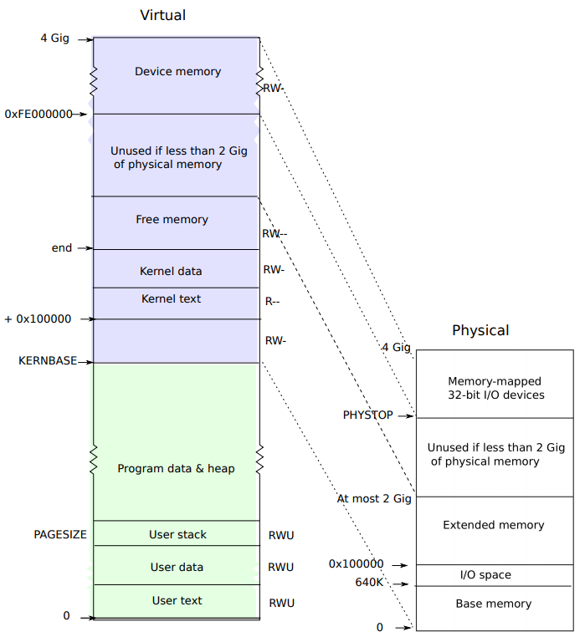
Virtual Physical Memory Mapping
A process’s user memory starts at virtual address zero and can grow up to KERNBASE, allowing a process to address up to 2 gigabytes of memory.
When a process asks xv6 for more memory :
finds free physical pages to provide the storage
adds PTEs to the process’s page table that point to the new physical pages
sets the PTE_U, PTE_W, and PTE_P flags in these PTEs.
xv6 leaves PTE_P clear in unused PTEs.
Different processes’ page tables translate user addresses to different pages of physical memory, so that each process has private user memory

Slide 11
Virtual Physical Memory Mapping
Xv6 includes all mappings needed for the kernel to run in every process’s page table; these mappings all appear above KERNBASE.
It maps virtual addresses KERNBASE:KERNBASE+PHYSTOP to 0:PHYSTOP.

Slide 12
Poll
A process user space starts from
+0x10000
KERNBASE
END
0

Slide 13
Design Component

Slide 14
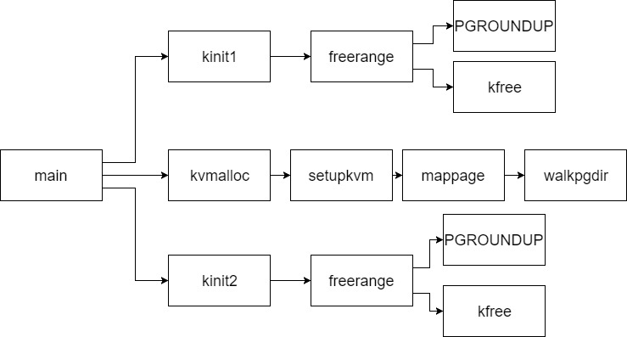
1216 int
1217 main(void)
1218 {
1219 kinit1(end, P2V(4*1024*1024)); // phys page allocator
1220 kvmalloc(); // kernel page table
1221 mpinit(); // detect other processors
1222 lapicinit(); // interrupt controller
1223 seginit(); // segment descriptors
1224 picinit(); // disable pic
1225 ioapicinit(); // another interrupt controller
1226 consoleinit(); // console hardware
1227 uartinit(); // serial port
1228 pinit(); // process table
1229 tvinit(); // trap vectors
1230 binit(); // buffer cache
1231 fileinit(); // file table
1232 ideinit(); // disk
1233 startothers(); // start other processors
1234 kinit2(P2V(4*1024*1024), P2V(PHYSTOP)); // must come after startothers()
1235 userinit(); // first user process
1236 mpmain(); // finish this processor’s setup
1237 }
1238
Design Components
kinit1() uses entrypgdir
Kinit2() uses Kernel Page directory created

Slide 15
Kernel Page Table
1219 kinit1(end, P2V(4*1024*1024));
end = KERNBASE + text + data part
4MB From 0(KERNBASE)
1234 kinit2(P2V(4*1024*1024), P2V(PHYSTOP));
Starting from 4MB to PHYSTOP typically 224MB
kinit2
kinit1
Around 740 kb
Design Components

Slide 16
The function main calls kinit1 and kinit2 to initialize the allocator (3131).
The reason for having two calls is that for much of main one cannot use locks or memory above 4 megabytes.
The call to kinit1 sets up for lock-less allocation in the ﬁrst 4 megabytes
The call to kinit2 enables locking and arranges for more memory to be allocatable.
kinit1 and kinit2 call freerange to add memory to the free list via per-page calls to kfree
freerange uses PGROUNDUP to ensure that it frees only aligned physical addresses
Physical Memory Allocation

Slide 17
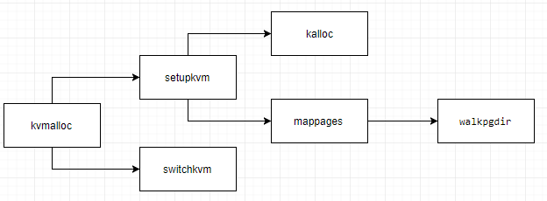
Main calls kvmalloc to create and switch to a page table with the mappings above KERNBASE required for the kernel to run.
setupkvm ﬁrst allocates a page of memory to hold the page directory.
mappages installs mappings into a page table for a range of virtual addresses to a corresponding range of physical addresses
kalloc removes and returns the ﬁrst element in the free list.
For each virtual address to be mapped, mappages calls walkpgdir to ﬁnd the address of the PTE for that address.
Switchkvm - Switch h/w page table register to the kernel−only page table, when no process is running.
Creating an Address Space

Slide 18
walkpgdir uses the upper 10 bits of the virtual address to ﬁnd the page directory entry.
If the page directory entry isn’t present, then the required page table page hasn’t yet been allocated; if the alloc argument is set, walkpgdir allocates it and puts its physical address in the page directory.
Finally it uses the next 10 bits of the virtual address to ﬁnd the address of the PTE in the page table page.
Creating an Address Space

Slide 19
Poll
Switch h/w page table register to the kernel−only page table, when no process is running
switchkvm
kvmalloc
Kinit1
mappages

Slide 20
Implementation

Slide 21
Kernel address space

Slide 22
3115 struct run {
3116 struct run *next;
3117 };
The allocator’s data structure is a free list of physical memory pages that are available for allocation.
Each free page’s list element is a struct run (3115).
3119 struct {
3120 struct spinlock lock;
3121 int use_lock;
3122 struct run *freelist;
3123 } kmem;
The free list is protected by a spin lock(3119~3123)
The list and the lock are wrapped in a struct to make clear that the lock protects the fields in the struct.
1500 // Mutual exclusion lock.
1501 struct spinlock {
uint locked; // Is the lock held?
1503
// For debugging:
char *name; // Name of lock.
struct cpu *cpu; // The cpu holding the lock.
uint pcs[10]; // The call stack (an array of program counters)
// that locked the lock.
1509 };
Free List – Implementation of run structure

Slide 23
3125 // Initialization happens in two phases.
3126 // 1. main() calls kinit1() while still using entrypgdir to place just
3127 // the pages mapped by entrypgdir on free list.
3128 // 2. main() calls kinit2() with the rest of the physical pages
3129 // after installing a full page table that maps them on all cores.
3130 void
3131 kinit1(void *vstart, void *vend)
3132 {
3133 initlock(&kmem.lock, "kmem");
3134 kmem.use_lock = 0;
3135 freerange(vstart, vend);
3136 }
3137
3138 void
3139 kinit2(void *vstart, void *vend)
3140 {
3141 freerange(vstart, vend);
3142 kmem.use_lock = 1;
3143 }
The call to kinit1 sets up for lock-less allocation in the first 4 megabytes.
The call to kinit2 enables locking and arranges for more memory to be allocatable.
kinit1(end, P2V(4*1024*1024));
kinit1 and kinit2
kinit2(P2V(4*1024*1024), P2V(PHYSTOP));

Slide 24
freerange uses PGROUNDUP to ensure that it frees only aligned physical addresses. (is a multiple of 4096)
The allocator starts with no memory; these calls to kfree give it some to manage.
xv6/kalloc.c
3151 freerange(void *vstart, void *vend)
3152 {
3153 char *p;
3154 p = (char*)PGROUNDUP((uint)vstart);
3155 for(; p + PGSIZE <= (char*)vend; p += PGSIZE)
3156 kfree(p);
3157 }
// Free the page of physical memory pointed at by v, which normally should have been returned by a call to kalloc(). (The exception is when initializing the allocator; see kinit above.)
3163 void
3164 kfree(char *v)
3165 {
3166 struct run *r;
3168 if((uint)v % PGSIZE || v < end || V2P(v) >= PHYSTOP)
3169 panic("kfree");
3172 memset(v, 1, PGSIZE);
3174 if(kmem.use_lock)
3175 acquire(&kmem.lock);
3176 r = (struct run*)v;
3177 r−>next = kmem.freelist;
3178 kmem.freelist = r;
3179 if(kmem.use_lock)
3180 release(&kmem.lock);
3181 }
Struct run r
Kmem.freelist
// Fill with junk to catch dangling refs. begins by setting every byte in the memory being freed to the value 1.
//kfree casts v to a pointer to struct run
freerange and kfree
//records the old start of the free list in r->next
//sets the free list equal to r.

Slide 25
Kvmalloc and setupkvm
1839 void
1840 kvmalloc(void)
1841 {
1842 kpgdir = setupkvm();
1843 switchkvm();
1844 }
1816 // Set up kernel part of a page table.
1817 pde_t*
1818 setupkvm(void)
1819 {
1820 pde_t *pgdir;
1821 struct kmap *k;
1822
1823 if((pgdir = (pde_t*)kalloc()) == 0)
1824 return 0;
1825 memset(pgdir, 0, PGSIZE);
1826 if (P2V(PHYSTOP) > (void*)DEVSPACE)
1827 panic("PHYSTOP too high");
1828 for(k = kmap; k < &kmap[NELEM(kmap)]; k++)
1829 if(mappages(pgdir, k−>virt, k−>phys_end − k−>phys_start,
1830 (uint)k−>phys_start, k−>perm) < 0) {
1831 freevm(pgdir);
1832 return 0;
1833 }
1834 return pgdir;
1835 }
kpgdir

Slide 26
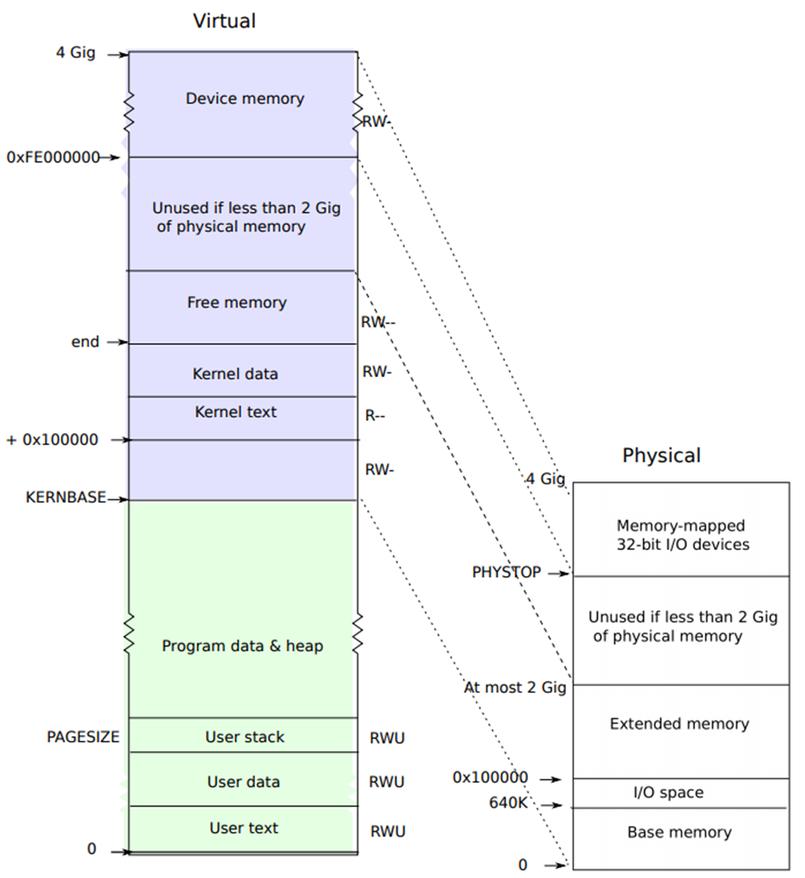
1804 static struct kmap {
1805 void *virt;
1806 uint phys_start;
1807 uint phys_end;
1808 int perm;
1809 } kmap[] = {
1810 { (void*)KERNBASE, 0, EXTMEM, PTE_W}, // I/O space
1811 { (void*)KERNLINK, V2P(KERNLINK), V2P(data), 0}, // kern text+rodata
1812 { (void*)data, V2P(data), PHYSTOP, PTE_W}, // kern data+memory
1813 { (void*)DEVSPACE, DEVSPACE, 0, PTE_W}, // more devices
1814 };
0200 // Memory layout
0201
0202 #define EXTMEM 0x100000 // Start of extended memory
0203 #define PHYSTOP 0xE000000 // Top physical memory
0204 #define DEVSPACE 0xFE000000 // Other devices are at high addresses
0205
0206 // Key addresses for address space layout (see kmap in vm.c for layout)
0207 #define KERNBASE 0x80000000 // First kernel virtual address
0208 #define KERNLINK (KERNBASE+EXTMEM) // Address where kernel is linked

Slide 27
1759 static int
1760 mappages(pde_t *pgdir, void *va, uint size, uint pa, int perm)
1761 {
1762 char *a, *last;
1763 pte_t *pte;
1764
1765 a = (char*)PGROUNDDOWN((uint)va);
1766 last = (char*)PGROUNDDOWN(((uint)va) + size − 1);
1767 for(;;){
//find the address of the PTE for that address.
1768 if((pte = walkpgdir(pgdir, a, 1)) == 0)
1769 return −1;
1770 if(*pte & PTE_P)
1771 panic("remap");
//PTE_P to mark the PTE as valid
1772 *pte = pa | perm | PTE_P;
1773 if(a == last)
1774 break;
1775 a += PGSIZE;
1776 pa += PGSIZE;
1777 }
1778 return 0;
1779 }
Create PTEs for virtual addresses starting at va that refer to physical addresses starting at pa.
va and size might not be page−aligned.
mappages installs mappings into a page table for a range of virtual addresses to a corresponding range of physical addresses.
It does this separately for each virtual address in the range, at page intervals.
For each virtual address to be mapped, mappages calls walkpgdir to ﬁnd the address of the PTE for that address.
It then initializes the PTE to hold the relevant physical page number, the desired permissions ( PTE_W and/or PTE_U), and PTE_P to mark the PTE as valid (1772).

Slide 28
1734 static pte_t *
1735 walkpgdir(pde_t *pgdir, const void *va, int alloc)
1736 {
1737 pde_t *pde;
1738 pte_t *pgtab;
1739 //uses the upper 10 bits of the virtual address to find the page directory entry
1740 pde = &pgdir[PDX(va)];
1741 if(*pde & PTE_P){
1742 pgtab = (pte_t*)P2V(PTE_ADDR(*pde));
1743 } else {
1744 if(!alloc || (pgtab = (pte_t*)kalloc()) == 0)
1745 return 0;
1746 // Make sure all those PTE_P bits are zero.
1747 memset(pgtab, 0, PGSIZE);
1748 // The permissions here are overly generous, but they can
1749 // be further restricted by the permissions in the page table
1750 // entries, if necessary.
1751 *pde = V2P(pgtab) | PTE_P | PTE_W | PTE_U;
1752 }
1753 return &pgtab[PTX(va)];
1754 }
Return the address of the PTE in page table pgdir that corresponds to virtual address va. If alloc!=0, create any required page table pages.
walkpgdir uses the upper 10 bits of the virtual address to ﬁnd the page directory entry.
If the page directory entry isn’t present, then the required page table page hasn’t yet been allocated; if the alloc argument is set, walkpgdir allocates it and puts its physical address in the page directory.
Finally it uses the next 10 bits of the virtual address to ﬁnd the address of the PTE in the page table page.

Slide 29
Create the First Process

Slide 30
Creating the first Process
This proc structure involves several concepts like synchronization, memory management, trap/interrupt, file systems.
struct proc {
uint sz; // Size of process memory (bytes)
pde_t* pgdir; // pointer for Page table Directory
char *kstack; // pointer that points to the bottom of the kernel stack for this process
enum procstate state; // Process state
int pid; // Process ID
struct proc *parent; // Parent Process
struct trapframe *tf; // pointer points to trapframe of current syscall
struct context *context; // swtch() here to run process
void *chan; // If non-zero, sleeping on chan; for multi-process
void *killed; // If non-zero, have been killed
struct file *ofile[NOFILE]; //Open files
struct inode *cwd; // Current directory
char name[16]; // Process name (debugging)
}
Prepare the Kernel Memory Space ( userinit(), setupkvm() )
Prepare Kernel Stack (allocproc() )
Prepare User Memory Space( userinit(), inituvm() )
Set up Trap Frame (allocproc(), userinit() )
Set up Context ( allocproc() )

Slide 31
2518 // Set up first user process.
2519 void
2520 userinit(void)
2521 {
2522 struct proc *p;
2523 extern char _binary_initcode_start[], _binary_initcode_size[];
2524
2525 p = allocproc();
2526
2527 initproc = p;
2528 if((p−>pgdir = setupkvm()) == 0)
2529 panic("userinit: out of memory?");
2530 inituvm(p−>pgdir, _binary_initcode_start, (int)_binary_initcode_size);
2531 p−>sz = PGSIZE;
2532 memset(p−>tf, 0, sizeof(*p−>tf));
2533 p−>tf−>cs = (SEG_UCODE << 3) | DPL_USER;
2534 p−>tf−>ds = (SEG_UDATA << 3) | DPL_USER;
2535 p−>tf−>es = p−>tf−>ds;
2536 p−>tf−>ss = p−>tf−>ds;
2537 p−>tf−>eflags = FL_IF;
2538 p−>tf−>esp = PGSIZE;
2539 p−>tf−>eip = 0; // beginning of initcode.S
userinit
// alloc resources for proc
// initproc is a static global pointer
get free space from freelist and map the virtual memory toward phyisical memory.
// setup kernel virtual memory
// init user virtual memory
// set up trap frame
// Descriptor privilege level to 3
2548 acquire(&ptable.lock);
2550 p−>state = RUNNABLE;
2551
2552 release(&ptable.lock);
2553 }

Slide 32
2468 // Look in the process table for an UNUSED proc.
2469 // If found, change state to EMBRYO and initialize
2470 // state required to run in the kernel.
2471 // Otherwise return 0.
2472 static struct proc*
2473 allocproc(void)
2474 {
2475 struct proc *p;
2476 char *sp;
2477
2478 acquire(&ptable.lock);
2479
2480 for(p = ptable.proc; p < &ptable.proc[NPROC]; p++)
2481 if(p−>state == UNUSED)
2482 goto found;
2483
2484 release(&ptable.lock);
2485 return 0;
2486
2487 found:
2488 p−>state = EMBRYO;
2489 p−>pid = nextpid++;
2490
Allocproc
2491 release(&ptable.lock);
2492
2493 // Allocate kernel stack.
2494 if((p−>kstack = kalloc()) == 0){
2495 p−>state = UNUSED;
2496 return 0;
2497 }
2498 sp = p−>kstack + KSTACKSIZE;
2499
Allocproc scans the proc table for a slot with state UNUSED (2480-2482).
It tries to allocate a kernel stack for the process’s kernel thread. If the memory allocation fails, allocproc changes the state back to UNUSED and returns zero to signal failure.
When it finds an unused slot, allocproc sets the state to EMBRYO to mark it as used and gives the process a unique pid

Slide 33
initcode.S
8400 # Initial process execs /init.
8401 # This code runs in user space.
8402
8403 #include "syscall.h"
8404 #include "traps.h"
8405
8406
8407 # exec(init, argv)
8408 .globl start
8409 start:
8410 pushl $argv
8411 pushl $init
8412 pushl $0 // where caller pc would be
8413 movl $SYS_exec, %eax
8414 int $T_SYSCALL
8415
8416 # for(;;) exit();
8417 exit:
8418 movl $SYS_exit, %eax
8419 int $T_SYSCALL
8420 jmp exit
8421
A process that is responsible for setting up the environment that the user sees (starting up terminals, etc.).
This process is called "init".
initcode.S is a wrapper around the exec call that loads /init.sh from disk and runs it.
a small amount of code that will run in a user process and exec the init process
8422 # char init[] = "/init\0";
8423 init:
8424 .string "/init\0"
8425
8426 # char *argv[] = { init, 0 };
8427 .p2align 2
8428 argv:
8429 .long init
8430 .long 0

Slide 34
2768 // Loop over process table looking for process to run.
2769 acquire(&ptable.lock);
2770 for(p = ptable.proc; p < &ptable.proc[NPROC]; p++){
2771 if(p−>state != RUNNABLE)
2772 continue;
2773
2774 // Switch to chosen process. It is the process’s job
2775 // to release ptable.lock and then reacquire it
2776 // before jumping back to us.
2777 c−>proc = p;
2778 switchuvm(p);
2779 p−>state = RUNNING;
2780
2781 swtch(&(c−>scheduler), p−>context);
2782 switchkvm();
2783
2784 // Process is done running for now.
2785 // It should have changed its p−>state before coming back.
2786 c−>proc = 0;
2787 }
2788 release(&ptable.lock);
2790 }
2791 }
Running the first Process
1251 static void
1252 mpmain(void)
1253 {
1254 cprintf("cpu%d: starting %d\n", cpuid(), cpuid());
1255 idtinit(); // load idt register
1256 xchg(&(mycpu()−>started), 1); // tell startothers() we’re up
1257 scheduler(); // start running processes
1258 }
2757 void
2758 scheduler(void)
2759 {
2760 struct proc *p;
2761 struct cpu *c = mycpu();
2762 c−>proc = 0;
2763
2764 for(;;){
2765 // Enable interrupts on this processor.
2766 sti();

